Slide 1
FoodLoop
Food waste reducing app
Created by – Team devRaven
Team Members
Abhishek Kumar (23SCSE1010692)
Akanksha (23SCSE1012163)
Pragati Nigam (23SCSE1011923)
Bablu Kumar (23SCSE1011944)

Slide 2
Introduction
FoodLoop aims to reduce food wastage by connecting donors with charities and NGOs, ensuring excess food reaches those in need.
By streamlining donations, requests, and deliveries, we aim to make food redistribution efficient and impactful
FoodLoop bridges the gap between surplus food and those in need, creating a sustainable ecosystem.
Every year, millions of tons of food are wasted while millions go hungry. Our solution aims to bridge this gap.

Slide 3
System Architecture
1
3
5
Donors
Delivery Personnel
NGO Requests
2
4
6
Admins
Food Donations
Delivery Tracking

Slide 4
Technology Stack
Frontend
Server
HTML, CSS, JavaScript
Apache Tomcat
Backend
Other Technologies
Java, Servlets, JSP, JDBC
Maven (For Dependency management)
Database
Platform
MySQL
Cross independent platform

Slide 5
Project Modules
Delivery Module
Request Module
To track delivery, update statuses.
View and approve donations for delivery.
User Module
Admin Module
To sign-up, log-in, Add donations, etc.
Features: Track deliveries, update statuses.

Slide 6
1
Users
Manages details of donors, admins, and delivery personnel.
4
Delhiveries
Database
Schema
Handles delivery assignments and tracking.
2
Donations
Tracks food donations made by users.
5
Relationships
User_id
Donation_id
Request_id
Delivery_person_id
3
Requests
Records requests from NGOs or admins for specific donations.

Slide 7
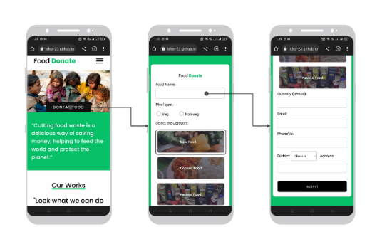
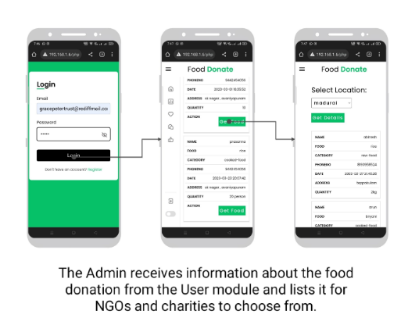
Demo Screenshot

Slide 8
Efficient Donation Management
Key Features
Managing food donations seamlessly
Real time tracking
Monitor the progress of food delivery.
NGO Integration
NGOs can track food availability and request it easily.
User Friendly
Simple UI for donors, admins, and delivery personnel.

Slide 9
Future Enhancement
Mobile App Integration
Create a mobile app to expand the reach.
Real time notifications
Pust notifications on new requests
AI Integration
Use AI to predict food wastage.

Slide 10
Conclusion
Project Summary: FoodLoop addresses the critical issue of food waste by connecting donors, NGOs, and delivery personnel through an efficient and streamlined system.
Key Features:
Seamless management of food donations and requests.
Real-time tracking of delivery statuses.
Role-based access for users, admins, and delivery personnel.
Impact: By simplifying the process of food redistribution, FoodLoop aims to minimize food waste and ensure surplus food reaches those in need, fostering a positive societal and environmental impact.

Slide 11
THANK YOU
TeamDevRaven © All Rights Reserved!

